Slide 1
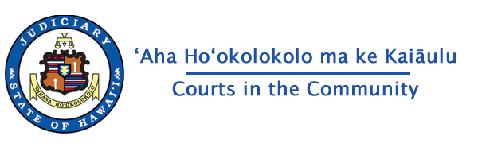
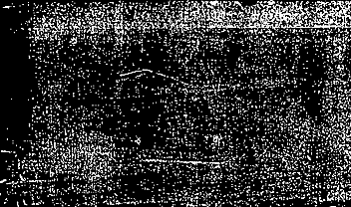

State v. Yuen
Overview & Background

Slide 2

Introduction
    This case is about why some evidence can or cannot be used in a criminal trial.
It involves important constitutional issues about the rights of the accused and the limits on the military’s role in civilian law enforcement.
THE INCIDENT
On October 25, 2018, a minor car accident took place outside Hickam Airforce Base. One of the people involved was Charles Tung Min Yuen. Airforce military police (MPs) were the first to arrive on the scene. When officers of the Honolulu Police Department (HPD) arrived, the MPs pointed out Mr. Yuen. The HPD officers determined that Mr. Yuen was intoxicated and arrested him on suspicion of Operating a Vehicle Under the Influence of an Intoxicant (OVUII).
The District Court found Mr. Yuen guilty, and the Intermediate Court of Appeals upheld Mr. Yuen’s conviction.

Slide 3

QUESTION PRESENTED
Whether the ICA gravely erred in holding that Yuen’s trial counsel was not ineffective for failing to file a motion to suppress?
Whether the ICA gravely erred in holding that there was substantial evidence to support Yuen’s conviction?

Slide 4
Sources of Law federal & state
Constitution
A Constitution is like a blueprint for how the government and the courts operate. Constitutions also recognize certain individual rights of citizens. The principles articulated in a Constitution guide the way we understand the law.
Statute
Statutes are the laws written by the legislature. Because legislatures are elected, statutory law is considered to represent the public will. However, it is not always easy to know exactly how the legislature intended a statute to be understood.
Case Law
Case law comes from the rulings that courts make. Many rulings involve interpreting statutes. The decisions of higher courts must be followed by lower courts; this is called Stare Decisis.
Regulation
Regulations are the rules created by government agencies. To the extent that regulations are within the scope of the agency’s authority, they have the force of law.

Slide 5
Contrasts in the legal system
Civil Cases
Criminal Cases
Brought by one individual (or entity) against another
Penalties mostly monetary damages (or an order to do or not do something)
Usually requires a preponderance (more than 50%) of the evidence to prevail
Brought by the State against an individual (or entity)
Penalties include imprisonment or even execution
The burden is on the Prosecution to prove every element of a crime beyond a reasonable doubt
Because there is a power imbalance between the parties, and so much at stake, there are additional procedural safeguards to protect the criminal defendant.

Slide 6

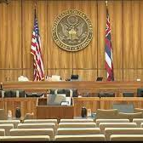
Criminal Court: Who are the players?
The Prosecution – The government lawyer (District Attorney, Federal Prosecutor) who initiates the proceedings.
The Defendant – The person against whom charges are brought. The defendant is almost always represented by a lawyer; in felony cases, a lawyer is appointed for a defendant who cannot afford one.
The Judge – The person who presides over the judicial process, ruling on motions, deciding questions of law, and presiding over trial (if there is one).
The Jury – The ordinary citizens entrusted with determining questions of fact and ultimately deciding whether the prosecution has proven their case.
In some cases, a defendant may waive his/her right to a jury trial and instead appear before a “bench trial,” where the judge also acts as the jury.

Slide 7
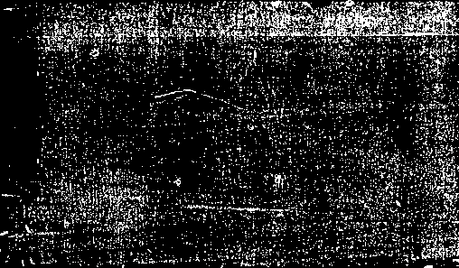
What does a criminal defense attorney do?
Initial Meeting
Often, a criminal defense attorney first meets their client after the client is arrested. The attorney will talk to the client about the case and may help arrange bail. The attorney will help the client decide whether to plead guilty, not guilty, or no contest. If a not guilty plea is entered, the case is given a trial date.
Research & Investigation
The attorney will investigate the relevant facts and research the applicable law. Based on the facts and the law, the attorney will determine the best legal strategy to meet the client’s goals.
Motions
Motions are the formal way that attorneys talk to the court. Both the prosecution and the defense can file motions to resolve legal issues and establish what evidence and testimony will be admissible at trial. Issues that are not raised by motion or at trial may be waived, that is they cannot be brought up later.
Trial
At trial, attorneys present evidence to a judge or jury. The Prosecution has the burden of proving all elements of a crime. If they fail to do so, the defendant will be found not guilty.
Appeal
An individual convicted of a crime may ask that his or her case be reviewed by a higher court. If that court finds an error in the case or the sentence imposed, the court may reverse the conviction or find that the case should be re-tried.

Slide 8
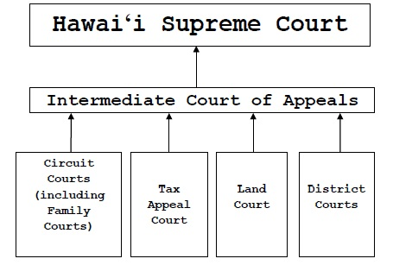
The Hawai‘i Courts

Slide 9
Appeals
When a trial court reaches its final decision on a case, the losing party has the option to appeal the decision in the hopes of getting it reversed (a new decision in favor of the losing party), or remanded (where the trial court essentially has a do-over).
In a criminal case the prosecution is not allowed to file an appeal if the court reaches a verdict in favor of the defense (e.g., if the court finds the defendant not guilty of the crime).
However, both the prosecution and the defense are free to file appeals on other disputes, including pre-trial motions.

Slide 10
Appeals
The ICA may overturn decisions of lower courts, and the Supreme Court may overturn decisions of the ICA.
The ICA must hear all cases appealed from lower courts (mandatory review), but the Hawaiʻi Supreme Court chooses whether or not to hear each case appealed from the ICA (discretionary review).
The federal courts follow similar procedures: the federal appeals courts must hear appeals from the trial courts, but the U.S. Supreme Court often chooses not to hear appeals. This effectively leaves the decisions of the federal appeals courts in place, and the losing party is at a dead end.

Slide 11
What Questions do courts decide?
The big question may seem simple:
  Who wins?
But courts must answer lots of other questions to get there.
Two main kinds of questions have to be answered during cases:
Questions of fact.
Questions of law.

Slide 12
Factual Questions
Questions of Fact:
Who, what, when, where, why, how.
Basically, questions of fact cover all of the questions about the things that happened, which have led to the case being brought to court.
Since the trial courts are the only ones who hear the witnesses, and see the evidence, they are better at judging facts.
Answering these questions is normally reserved for the jury. Often, courts will refer to the jury as the “trier of fact.”

Slide 13
Legal Questions
Questions of Law - These questions aren’t about what happened:
  What is the law?
  Was the law applied correctly by the lower court?
Answering these questions is reserved for the judge. Courts refer to the judge as the “trier of law.”
Appeals courts merely look at the record of the case from the trial court.
Witnesses and juries are not part of the appeals process.
Appeals usually focus on questions of law.

Slide 14
Legal Questions
The law does not come from just one source.
Constitutional law (master plan for how the government operates and what rights
Statutory law (laws enacted by a legislature).
Case law (rules developed by courts over time).
Even when it a law written down, it may not be obvious how it applies.
E.g., “No vehicles in the park.”
  I understand I cannot drive my car in the park.
  Can my child cannot ride a tricycle in the park?
  What about pushing a baby in a stroller?
Notes:
NOTE: This should not be an opportunity to divert into a discussion of the “no vehicles in the park” issue; it should just be an illustration of the basic point.

Slide 15

State v. Yuen
The case

Slide 16
The Facts of the case
Mr. Yuen was involved in a car accident on October 25, 2018. The accident took place about 50 feet from the guard gate outside Hickam Airforce Base. It has been established that this is in the jurisdiction of city and county law enforcement, rather than military jurisdiction.
The first law enforcement officers to interact with Mr. Yuen were MPs from the base. They detained him, questioned him, and administered a field sobriety test.
When officers of the HPD arrived, the MPs pointed out Mr. Yuen, who was sitting in his car. The HPD officers questioned Mr. Yuen and noted that he had red, watery eyes, slurred speech, and they smelled alcohol on his breath. The officers administered standard field sobriety tests. Mr. Yuen performed poorly on the tests, including swaying, hopping, using his arms for balance, and at one point stating, “I quit. I quit.”
Mr. Yuen was arrested for OVUII.

Slide 17
How the case reached the Supreme Court
The District Court found Mr. Yuen guilty.
Mr. Yuen’s trial attorney made a pretrial motion about the admissibility of the MPs investigation, stating that the incident occurred on Hickam Air Force Base. The judge did not rule because prosecution did not introduce this evidence.
The Intermediate Court of Appeals affirmed the trial court’s decision.
The ICA issued a Summary Disposition Order upholding the conviction.
The State applied for writ of certiorari (permission to appeal to the Supreme Court). The writ was granted and here we are.
In a Motion for Judgement of Acquittal, trial counsel again argued that the State had not proved that incident occurred on City and County property.
The ICA gave Mr. Yuen leave to file a motion for Ineffective Assistance of Counsel.
It makes sense for the Supreme Court to hear the case, since there are issues of constitutional rights and the balance between state and federal power

Slide 18
Evidentiary issues
This case is not really about the facts of the offense Mr. Yuen is charged with committing.
This case is about the admissibility and sufficiency of evidence.
That is, whether the State followed all the rules to ensure that Mr. Yuen’s rights were protected. Mr. Yuen argues that the evidence used to establish his guilt was collected in an inappropriate way.

Slide 19
Why are evidence rules important?
The United States and Hawai'i Constitutions both guarantee the right to be free from “unreasonable searches and seizures” unless there is “probable cause” to believe that a crime has been committed. Evidence resulting from a search or seizure without probable cause may be excluded at trial.
If wrongly gathered evidence leads to more evidence, then all the evidence is excluded. This is called “Fruit of the Poison Tree.”
This rule is intended to ensure that law enforcement officers and the State follow all the appropriate rules and procedures so that innocent people are not unfairly prosecuted or jailed.

Slide 20
Posse Comitatus Act
The Act prevents the use of the military “as a posse comitatus or otherwise to execute the laws” unless “expressly authorized by the Constitution or an Act of Congress.”
The Act, originally passed in 1878, was a response to the military occupation of the former Confederate States during the Reconstruction period after the Civil War. The period following removal of federal troops saw the suppression of African-American political participation and the establishment of Jim Crow laws in the South.
Despite its problematic origins, the Act reflects a widely held belief that the military should not play a part in civilian law enforcement.

Slide 21
State v. Pattioay
In Pattioay, military and civilian law enforcement collaborated on a narcotics investigation.
The Hawai'i Supreme Court held, “Where the target of a military investigation is a civilian and there is no verified connection to military personnel, the PCA prohibits military participation in activities designed to execute civilian laws.”
The Court ruled that the evidence gathered in violation of the Posse Comitatus Act should be excluded.
“We hold that it is imperative in this case to suppress the evidence obtained in violation of the PCA because to ignore the violation and allow the evidence to be admitted would be to justify the illegality and condone the receipt and use of tainted evidence in the courts of this state.”

Slide 22
Ineffective counsel
To overturn his verdict, Mr. Yuen wants the court to suppress all the evidence resulting from the violation of the Posse Comitatus Act. However, in many cases, if you do not move to exclude evidence at trial, the issue is waived (it is too late to complain about it later). So, Mr. Yuen wants to prove that his trial counsel made important mistakes.
Trial Counsel seemed to believe the incident happened on military property
Trial Counsel did not move to exclude testimony from the HPD officers because they collaborated with the MPs in violation of the Posse Comitatus Act
“To demonstrate that trial counsel is constitutionally ineffective, a defendant must demonstrate 1) that there were specific errors or omissions reflecting counsel’s lack of skill, judgment, or diligence; and 2) that such errors or omissions resulted in either the withdrawal or substantial impairment of a potentially meritorious defense.”
-Grindling v. State

Slide 23
standard of review
The standard of review is the amount of deference given by one court in reviewing the decision by a lower court.
A court’s conclusions of law regarding a petition for post-conviction relief are reviewed de novo.
This means that the Supreme Court will decide the case based on the Court’s own understanding of the law, without giving deference to decision by the district court or the ICA.
A court’s findings of fact in connection with a petition for post-conviction relief are reviewable under the clearly erroneous standard.
This means that, even if the Supreme Court disagrees with the lower court’s decision on an issue, the decision will stand unless it is obviously wrong.

Slide 24
Mr. Yuen’s Argument
Mr. Yuen contends that the involvement of the MPs when they detained him, questioned him, and administered a field sobriety test, violated the Posse Comitatus Act.
Mr. Yuen argues that all evidence stemming from the MPs involvement, including the subsequent investigation by HPD is Fruit of the Poisonous Tree and should have been excluded as well.
Mr. Yuen argues that the failure of his trial counsel to raise these issues at trial shows that he received ineffective assistance of counsel.
For these reasons, his conviction should be overturned.

Slide 25
State’s Argument
The State contends that the MPs were only taking reasonable measures in response to an incident right outside the entrance to the base.
The State argues that, even if the MPs did get involved, the HPD conducted their own independent investigation. Furthermore, no evidence or testimony from the MPs was introduced at trial. So, to the extent that any technical rules were violated, Mr. Yuen suffered no harm.
Since there was no valid claim that the evidence should have been excluded, Mr. Yuen’s trial counsel was not ineffective for not raising the issue.
Therefore, the conviction should be upheld.

Slide 26
Relevant sources of law
U.S. Constitution, Amend. IV
Hawai'i Constitution, Art. I, Sect. 7
18 USCS § 1385 (Posse Comitatus Act)
State v. Pattioay, 78 Hawai'i 455, 896 P.3d 911 (1995)(holding that evidence gathered in violation of PCA must be excluded)
Grindling v. State, 146 Hawai'i 299, 463 P.3d 956 (2020)(holding that failure to raise a meritorious argument constitutes ineffective assistance of counsel)

Slide 27
Any questions?

