Slide 1



State v. Zuffante
Overview & Background

Slide 2

INTRODUCTION
This case is about the due process rights of a criminal defendant during a police interrogation
It involves the constitutional rights of the accused and the responsibilities of the police.
THE INCIDENT
Charles Zuffante was arrested after a traffic stop during which police found drugs in the car in which he was driving.
Following his arrest, Mr. Zuffante was questioned at the police station. Only Mr. Zuffante and the police officer were present, and the questioning was not recorded. Mr. Zuffante made incriminating statements during the interrogation.
At trial, the officer testified that Mr. Zuffante voluntarily waived his right to remain silent and made incriminating statements during the interrogation. Mr. Zuffante contested this version of events and took the witness stand in his own defense. Zuffante was convicted of attempted distribution of methamphetamines.

Slide 3

QUESTIONS PRESENTED
1. Whether the ICA gravely erred in affirming the trial court’s admission of Officer Gaspar’s testimony?
2. Whether Kekona should be overruled?
3. Whether the ICA gravely erred in finding there was sufficient evidence for the jury to convict Mr. Zuffante?
4. Whether the ICA gravely erred in concluding the record was not sufficiently developed for it to decide whether there was ineffective assistance of counsel?

Slide 4
CONTRASTS IN THE LEGAL SYSTEM
Civil Cases
Criminal Cases
Brought by one individual (or entity) against another
Penalties mostly monetary damages (or an order to do or not do something)
Usually requires a preponderance (more than 50%) of the evidence to prevail
Brought by the State against an individual (or entity)
Penalties include imprisonment or even execution
The burden is on the Prosecution to prove every element of a crime beyond a reasonable doubt

Slide 5
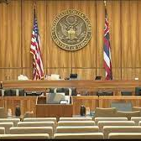
CRIMINAL COURT: WHO ARE THE PLAYERS?
The Prosecution – The government lawyer (District Attorney, Federal Prosecutor) who initiates the proceedings.
The Defendant – The person against whom charges are brought. The defendant is almost always represented by a lawyer; in felony cases, a defendant who cannot afford a lawyer has the right to a court-appointed attorney.
The Judge – The person who presides over the judicial process, ruling on motions, deciding questions of law, and presiding over trial (if there is one).
The Jury – The ordinary citizens entrusted with determining questions of fact and ultimately deciding whether the prosecution has proven their case.
In some cases, a defendant may waive his/her right to a jury trial and instead appear before a “bench trial,” where the judge also acts as the jury.

Slide 6
SOURCES OF LAW
FEDERAL & STATE
Constitution
  A Constitution is like a blueprint for how the government and the courts operate. Constitutions also recognize certain individual rights of citizens. The principles articulated in a Constitution guide the way we understand the law.
Statute
  Statutes are the laws written by the legislature. Because legislatures are elected, statutory law is considered to represent the public will. However, it is not always easy to know exactly how the legislature intended a statute to be understood.
Case Law
  Case law comes from the rulings that courts make. Many rulings involve interpreting statutes. The decisions of higher courts must be followed by lower courts; this is called Stare Decisis.
Regulation
  Regulations are the rules created by government agencies. To the extent that regulations are within the scope of the agency’s authority, they have the force of law.

Slide 7
APPEALS
When a trial court reaches its final decision on a case, the losing party has the option to appeal the decision in the hopes of getting it reversed (a new decision in favor of the losing party), or remanded (where the trial court essentially has a do-over).
In order to appeal specific decisions made by the judge at trial, like rulings on what evidence to admit, the attorney must raise the objection at the time.
In a criminal case the prosecution is not allowed to file an appeal of a not guilty verdict in favor of the defendant.
However, both the prosecution and the defense can appeal specifc decisions on other disputes.
In this case, the defense is appealing both the outcome and the judge’s decision to admit Mr. Zuffante’s statement made during interrogation.

Slide 8

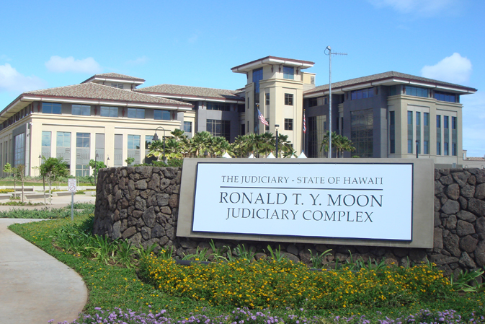
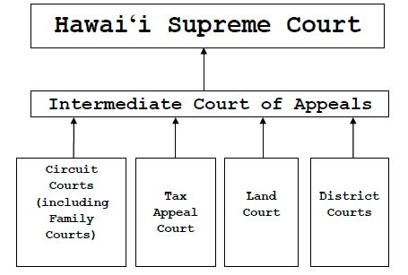
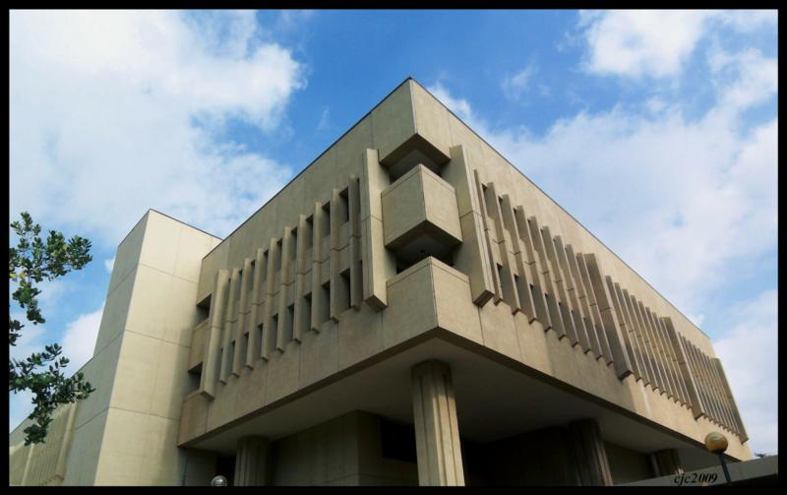
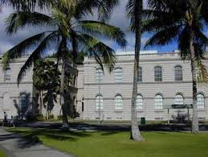
THE HAWAI‘I COURTS

Slide 9

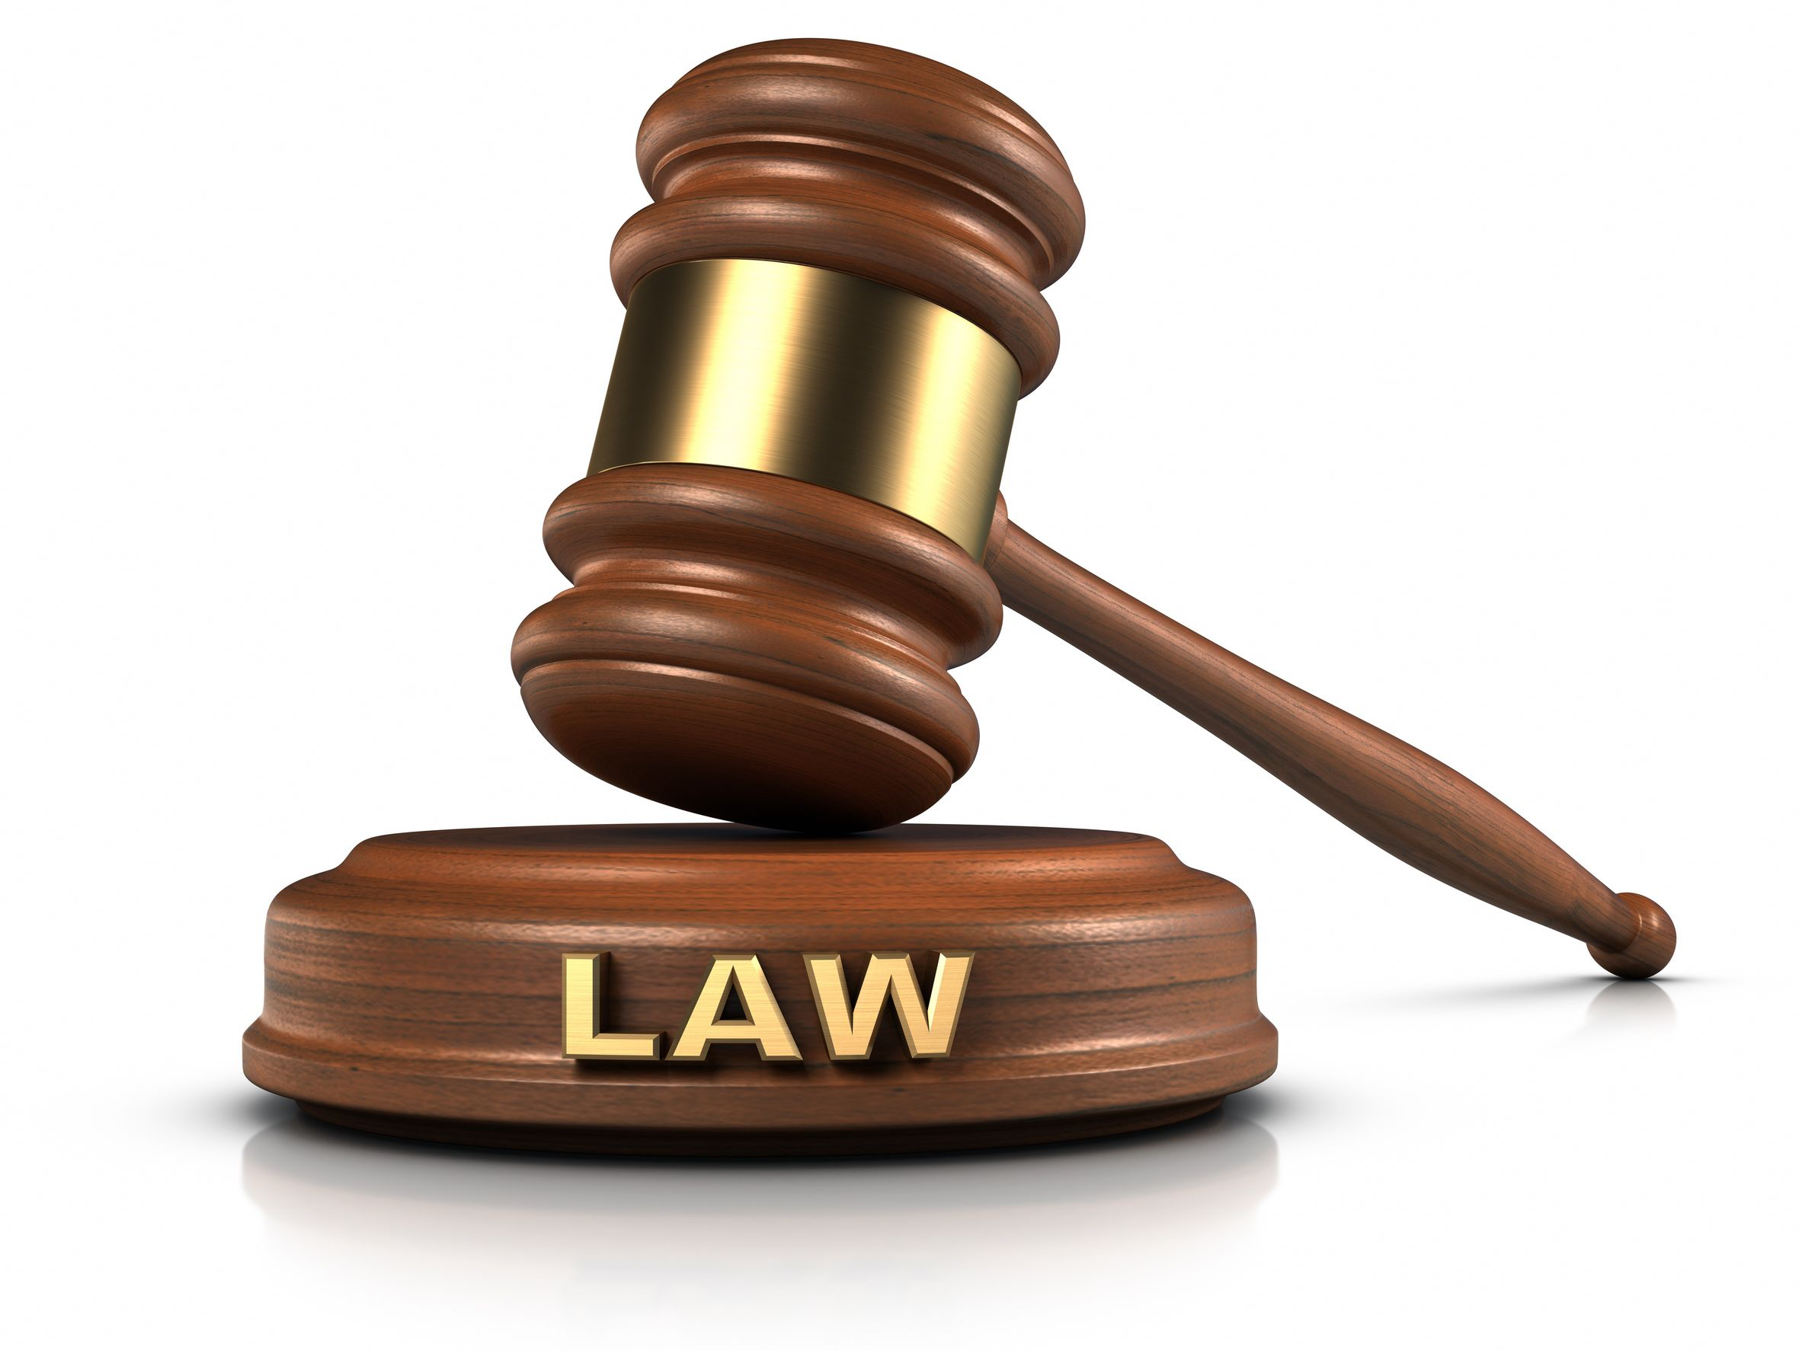
WHAT QUESTIONS DO COURTS DECIDE?
The big question may seem simple:
  Who wins?
But courts must answer lots of other questions to get there.
Two main kinds of questions have to be answered during cases:
Questions of fact.
Questions of law.

Slide 10
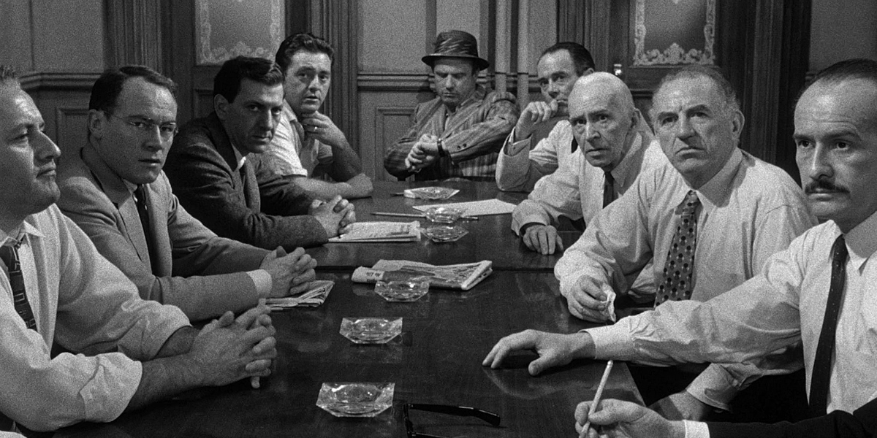
FACTUAL QUESTIONS
Questions of Fact:
Who, what, when, where, why, how.
Basically, questions of fact cover all of the questions about the things that happened, which have led to the case being brought to court.
Since the trial courts are the only ones who hear the witnesses, and see the evidence, they are better at judging facts.
Answering these questions is normally reserved for the jury. Often, courts will refer to the jury as the “trier of fact.”

Slide 11
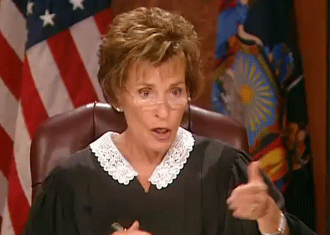
LEGAL QUESTIONS
Questions of Law - These questions aren’t about what happened:
  What is the law?
  Was the law applied correctly by the lower court?
Answering these questions is reserved for the judge. Courts refer to the judge as the “trier of law.”
Appeals courts merely look at the record of the case from the trial court.
Witnesses and juries are not part of the appeals process.
Appeals usually focus on questions of law.

Slide 12


LEGAL QUESTIONS
Sometimes legal questions arise because a situation is novel or new.
When the Constitution was written, there were no telephones, computers, or AK-47s
  How does the right to free speech change when we communicate with TikTok and Instagram instead of letters and newspapers?
  Is the right to bear arms different today because guns can fire hundreds of bullets per minute instead of taking two minutes to reload and not working when it rains?
Even when a law written down, it may not be obvious how it applies.
The rule is “No vehicles in the park.”
  I understand I cannot drive my car in the park.
  Are Segway tours allowed?
  Can my child ride a tricycle in the park?
  What about pushing my baby in a stroller?
Notes:
NOTE: This should not be an opportunity to divert into a discussion of the “no vehicles in the park” issue; it should just be an illustration of the basic point.

Slide 13

State v. Zuffante
THE CASE

Slide 14
THE FACTS OF THE CASE
Charles Zuffante was riding with his girlfriend in Kona, Hawaiʻi, when police officers pulled them over for a traffic stop. Police saw drug paraphernalia in the car and found methamphetamine in Mr. Zuffante’s pocket. Mr. Zuffante was arrested and more drugs were found when police searched the car.
At the police station, Mr. Zuffante was questioned by Officer Gaspar. Mr. Zuffante described how he had sold drugs in the past, stated that everything in the car was his, and said that he did not want his girlfriend arrested. Officer Gaspar was the only person present for the interrogation. No recording was made of the interrogation because the recording equipment at the police station was broken. Officer Gaspar recorded his report of the interrogation a week later.
At trial, the judge allowed Officer Gaspar to testify about the interrogation. Mr. Zuffante took the stand in his own defense. Mr. Zuffante was found guilty of attempted distribution of methamphetamine.

Slide 15
HOW THE CASE REACHED THE SUPREME COURT
The Circuit Court found Mr. Zuffante guilty.
  Mr. Zuffante’s attorney made a pretrial motion to exclude Officer Gaspar’s testimony. After the judge allowed the evidence, the attorney did not raise further objections during Officer Gaspar’s testimony.
The Intermediate Court of Appeals affirmed the trial court.
  The ICA issued a Summary Disposition Order upholding the conviction.
The Supreme Court agreed to hear the case on a writ of certiorari because of the Constitutional issues raised and because Defendant is asking the Court to overrule its own precedent.

Slide 16
ATTEMPTED PROMOTION OF A DANGEROUS DRUG IN THE FIRST DEGREE
HRS § 705-500 Criminal attempt.
(1) A person is guilty of an attempt to commit a crime if the person:
  (a) Intentionally engages in conduct which would constitute the crime if the attendant circumstances were as the person believes them to be; or
  (b) Intentionally engages in conduct which, under the circumstances as the person believes them to be, constitutes a substantial step in a course of conduct intended to culminate in the person's commission of the crime.
(2) When causing a particular result is an element of the crime, a person is guilty of an attempt to commit the crime if, acting with the state of mind required to establish liability with respect to the attendant circumstances specified in the definition of the crime, the person intentionally engages in conduct which is a substantial step in a course of conduct intended or known to cause such a result.
(3) Conduct shall not be considered a substantial step under this section unless it is strongly corroborative of the defendant's criminal intent.
HRS § 712-1241 Promoting a dangerous drug in the first degree.
(1) A person commits the offense of promoting a dangerous drug in the first degree if the person knowingly:
  (b) Distributes:
    (ii) One or more preparations, compounds, mixtures, or substances of an aggregate weight of:
      (A) One-eighth ounce or more, containing methamphetamine, heroin, morphine, or cocaine or any of their respective salts, isomers, and salts of isomers; or
      (B) Three-eighths ounce or more, containing any other dangerous drug[.]

Slide 17
SUBSTANTIVE GUILT V. CONSTITUTIONAL DUE PROCESS
This case is less about the facts of the crime Mr. Zuffante is charged with committing.
This case is more about Constitutional protections for criminal defendants
That is, whether the State followed all the rules to ensure that Mr. Zuffante’s rights were protected.
Mr. Zuffante argues that admitting evidence of his interrogation at trial violated his rights.

Slide 18
WHY IS PROCESS IMPORTANT
The Rights of the Accused
Criminal cases involve a power imbalance. It is the government against an individual. If the defendant loses, they might lose their property, freedom, or even their lives. So, Constitutional protections are important, even when the accused is a bad guy.
Responsibilities of the Police and Prosecutors
Rules about process also keep the people enforcing our laws from cutting corners. Requiring police and prosecutors to abide by certain standards makes them do their job more carefully. There are different opinions about whether this lets too many guilty people go free or helps to protect everyone from mistakes and abuse.

Slide 19
CONSTITUTIONAL RIGHTS
Miranda Rights
Right Against Self-Incrimination
Right to Effective Counsel
  Police must read the Miranda warning to any suspect in custody who they plan to question in order for the suspect’s statements to be used at trial. The warning informs the suspect of the right to remain silent and the right to have a lawyer present.
  The Fifth Amendment protects individuals against being forced to testify against themselves in a criminal case. A criminal defendant’s testimony must be voluntary (they understand their rights and choose to testify).
  The Sixth Amendment guarantees that criminal defendants have the right to an attorney and that this legal representation be competent and adequate.

Slide 20
STEPHAN V. STATE
ALASKA SUPREME COURT 1985
Mr. Stephan (whose case was combined with another with similar facts) moved to suppress a confession made during his interrogation. Stephan claimed that his ultimate confession was induced by promises of leniency and was obtained in the absence of an attorney, after he requested one. The testimony of the police was to the contrary. The interview was not recorded in its entirety and the officers’ reports was written later.
The Court adopted a rule requiring that custodial interrogations in a place of detention must be recorded, including the giving of the Miranda rights.
“In the absence of an accurate record, the accused may suffer an infringement upon his right to remain silent and to have counsel present during the interrogation.”
“The recording of custodial interrogations is not, however, a measure intended to protect only the accused; a recording also protects the public's interest in honest and effective law enforcement, and the individual interests of those police officers wrongfully accused of improper tactics.”

Slide 21
STATE V. KEKONA
HAWAI‘I SUPREME COURT 1995
Mr. Kekona was charged with robbery and assault. He was questioned while in custody. The police said he was read his Miranda Warning and gave a statement implicating himself. Mr. Kekona said that he was not read his rights, and that the interrogation involved pressure tactics. The questioning was not recorded, even though recording equipment was available.
The Court ruled that custodial interrogations need not be recorded to be admissible at trial.
“We cannot say that the failure of the police to manufacture a tape recording of Kekona's station house interrogation was so detrimental to his defense that it necessarily resulted in an unfair trial.”
“Undeniably, recording a custodial interrogation is important in many contexts. A recording would be helpful to both the suspect and the police by obviating the ‘swearing contest’ which too often arises when an accused maintains that she asserted her constitutional right to remain silent or requested an attorney and the police testify to the contrary.”
Justice Levinson’s dissent: “The majority's unwillingness to adopt the Stephan rule expressly, when it seems to have done so impliedly, is particularly bizarre because this court has historically been in the forefront of extending the rights and liberties of persons subject to local law on independent state constitutional grounds.”

Slide 22
INTERRELATION OF THE QUESTIONS PRESENTED
Kekona should be overruled because allowing Officer Gaspar to testify about Mr. Zuffante’s statements made during interrogation violated his Constitutional due process rights
Mr. Zuffante’s decision to testify at trial (despite his right against self-incrimination) was not voluntary because there was no other way to rebut Officer Gaspar’s testimony
In the absence of Officer Gaspar’s testimony, there was insufficient evidence to convict Mr. Zuffante
To the extent any issues were not preserved for appeal, that is the result of ineffective representation of counsel

Slide 23
STANDARD OF REVIEW
CONSTITUTIONAL QUESTIONS
Questions of constitutional law are reviewed de novo, under the right/wrong standard.
ADMISSIBILITY OF EVIDENCE
When the application of a particular evidentiary rule can yield only one correct result, the proper standard for appellate review is the right/wrong standard.
The abuse of discretion standard applies when rules of evidence require a judgment call.
SUFFICIENCY OF EVIDENCE
Evidence adduced in the trial court must be considered in the strongest light for the prosecution when the appellate court passes on the legal sufficiency of such evidence to support a conviction. The test on appeal is not whether guilt is established beyond a reasonable doubt, but whether there was substantial evidence to support the conclusion of the trier of fact.
Indeed, even if it could be said that the conviction is against the weight of the evidence, as long as there is substantial evidence to support the requisite findings for conviction, the trial court will be affirmed.

Slide 24
STATE’S ARGUMENT
This is a run-of-the-mill drug distribution case. During a legal traffic stop, police found methamphetamine on Mr. Zuffante’s person and in the car. At the police station, Mr. Zuffante was given a Miranda warning. In the course of questioning, Mr. Zuffante made incriminating statements. These statements were not recorded because the equipment at the police station was broken.
It was appropriate for the Court to allow Officer Gaspar’s testimony at trial. Defendant should not be permitted to challenge the conviction now because he failed to object to the testimony at trial. Defendant was appraised by the judge, not once but three times, of his right not to testify. He chose to do so voluntarily. A jury considered all the evidence and found Defendant guilty.
Thus, the Defendant’s rights were respected, and the verdict should not be disturbed.

Slide 25
MR. ZUFFANTE’S ARGUMENT
Mr. Zuffante was in custody when he was subject to interrogation by Officer Gaspar with no other witnesses present. In the absence of a recording, there is no way to assure that Mr. Zuffante’s interrogation met all Constitutional due process requirements. There was also no way for Mr. Zuffante to respond to what he felt were inaccuracies in Officer Gaspar’s testimony except to testify on his own behalf. As a result, Mr. Zuffante decision to forego his right against self-incrimination was not truly voluntary.
In the absence of Officer Gaspar’s testimony, there was insufficient evidence to convict Mr. Zuffante.
Hawai‘i has a strong tradition of protecting the rights of the accused. Adopting a rule requiring that all custodial interrogations be recorded to be admissible at trial would be aligned with this tradition.
Therefore, the Court should overrule Kekona and adopt a version of the Stephan rule and Mr. Zuffante’s conviction should be overturned.

Slide 26
RELEVANT SOURCES OF LAW
State v. Kekona, 77 Hawai`i 403, 410, 886 P.2d 740, 747 (1994)
Stephan v. State, 711 P.2d 1156 (Alaska 1985)
Miranda v. Arizona, 384 U.S. 436, 444, 86 S.Ct. 1602 (1966)
State v. Kazanas, 138 Hawai’i 23, 36, 375 P.3d 1261, 1264 (2016)
State v. Tachibana, 79 Hawai`i 226, 900 P.2d 1293 (1995)
State v. Ugalino, 107 Hawai`i 144, 111 P.3d 39 (2002) cert. den., 107 Hawai`i 348, 113 P.3d 799 (May 5, 2005)
HRS § 712-1241
HRS § 705-500

Slide 27
ANY QUESTIONS?

