Slide 1




Nonhuman Rights Project on behalf of Mari and Vaigai v. City & County of Honolulu
Overview & Background

Slide 2

INTRODUCTION
This case is about how the legal system views animals and whether habeas corpus applies to nonhuman animals
The Nonhuman Rights Project (NhRP) is an organization dedicated to securing legal rights for animals. The organization has brought multiple lawsuits around the country arguing that animals, especially cognitively complex animals like elephants, should have some of the same legal rights as humans.
Mari and Vaigai are two Asian elephants who have lived at the Honolulu Zoo for 34 years. NhRP petitioned for writ of habeas corpus, arguing that Mari and Vaigai should be released to an elephant sanctuary. Habeas corpus is a legal concept that originated in medieval England. A habeas petition allows a prisoner to question the legality of their detention.
The Circuit Court for the First Circuit (circuit court) dismissed NhRP’s petition. The Intermediate Court of Appeals (ICA) upheld the circuit court’s decision.

Slide 3

QUESTIONS PRESENTED
Does HRS chapter 660 supersede the common law writ of habeas corpus?
If HRS chapter 660 does not supersede the common law writ of habeas corpus, does the common law writ apply to nonhuman animals like Mari and Vaigai?

Slide 4

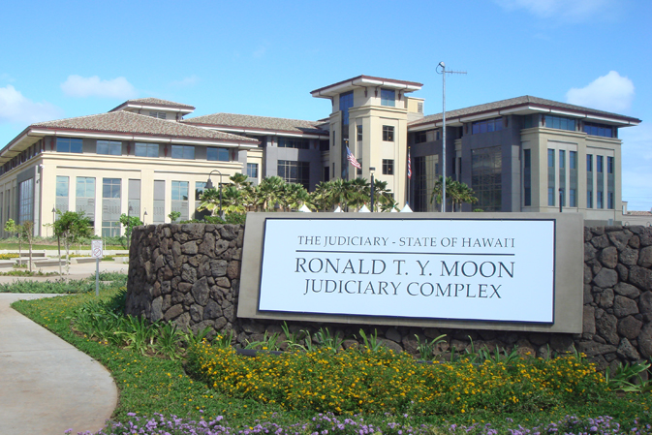
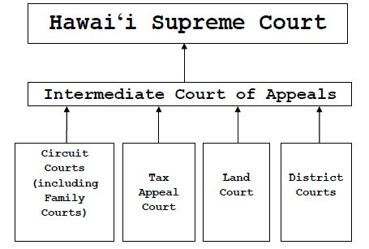
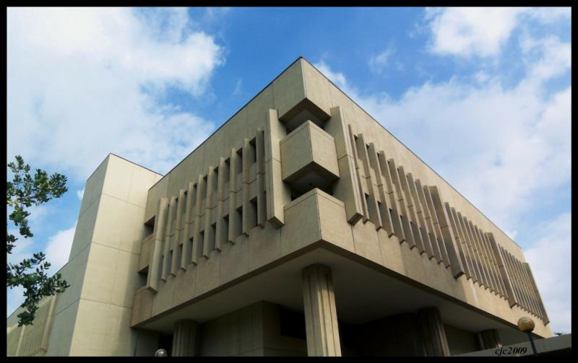

THE HAWAI‘I COURTS

Slide 5
APPEALS
When a trial court reaches its final decision on a case, the losing party has the option to appeal the decision in the hopes of getting it reversed (a new decision in favor of the losing party) or remanded (where the trial court essentially has a do-over).
The ICA may review decisions of lower courts, and the Supreme Court may review decisions of the ICA. The ICA must hear all cases appealed from lower courts (mandatory review), but the Hawaiʻi Supreme Court chooses whether or not to hear each case appealed from the ICA (discretionary review). In some cases, the Supreme Court may choose to take a case directly from the trial court, particularly if it is a case of “fundamental public importance.”
The federal courts follow similar procedures: the federal appeals courts must hear appeals from the trial courts, but the U.S. Supreme Court often chooses not to hear appeals.

Slide 6
SOURCES OF LAW
FEDERAL & STATE
Constitution
  A Constitution is like a blueprint for how the government and the courts operate. Constitutions also recognize certain individual rights of citizens. The principles articulated in a Constitution guide the way we understand the law.
Statute
  Statutes are the laws written by the legislature. Because legislatures are elected, statutory law is considered to represent the public will. However, it is not always easy to know exactly how the legislature intended a statute to be understood.
Case Law
  Case law comes from the rulings that courts make. Many rulings involve interpreting statutes. The decisions of higher courts must be followed by lower courts; this is called Stare Decisis.
Regulation
  Regulations are the rules created by government agencies. To the extent that regulations are within the scope of the agency’s authority, they have the force of law.

Slide 7


WHAT QUESTIONS DO COURTS DECIDE?
The big question may seem simple:
  Who wins?
But courts must answer lots of other questions to get there.
Two main kinds of questions have to be answered during cases:
Questions of fact.
Questions of law.

Slide 8
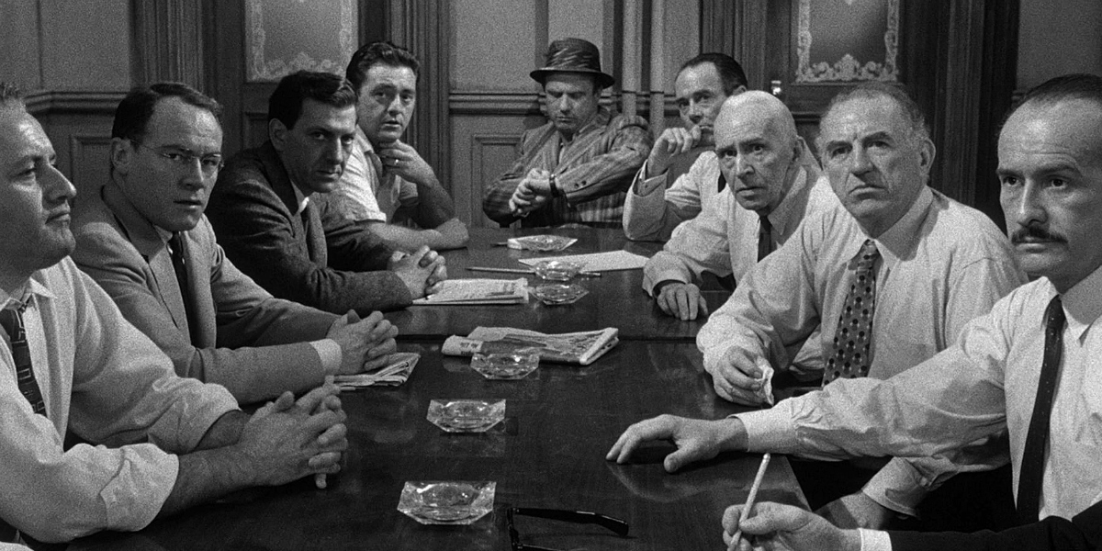
FACTUAL QUESTIONS
Questions of Fact:
Who, what, when, where, why, how.
Basically, questions of fact cover all of the questions about the things that happened, which have led to the case being brought to court.
Since the trial courts are the only ones who hear the witnesses, and see the evidence, they are better at judging facts.
Answering these questions is normally reserved for the jury. Often, courts will refer to the jury as the “trier of fact.”

Slide 9
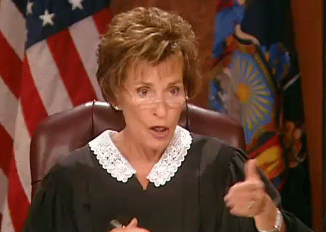
LEGAL QUESTIONS
Questions of Law - These questions aren’t about what happened, they are about the law:
  What is the law?
  Was the law applied correctly by the lower court?
Answering these questions is reserved for the judge. Courts refer to the judge as the “trier of law.”
Appeals courts merely look at the record of the case from the trial court.
Witnesses and juries are not part of the appeals process.
Appeals usually focus on questions of law.

Slide 10


LEGAL QUESTIONS
Sometimes legal questions arise because a situation is novel or new.
When the Constitution was written, there were no telephones, computers, or AK-47s
  How does the right to free speech change when we communicate with TikTok and Instagram instead of letters and newspapers?
  Is the right to bear arms different today because guns can fire hundreds of bullets per minute instead of taking two minutes to reload and not working when it rains?
Even when a law written down, it may not be obvious how it applies.
The rule is “No vehicles in the park.”
  I understand I cannot drive my car in the park.
  Are Segway tours allowed?
  Can my child ride a tricycle in the park?
  What about pushing my baby in a stroller?

Slide 11
Nonhuman Rights Project on behalf of Mari and Vaigai v.
City & County of Honolulu
THE CASE

Slide 12
NhRP’S ARGUMENT
NhRP contends that at common law, habeas corpus has been a flexible and adaptable doctrine and extending the definition to include nonhuman animals would be “consistent with the Great Writ’s historical function of challenging the detention of individuals deemed property.” NhRP argues that it is thus entitled to an evidentiary hearing before the circuit court so that the court can review the merits of NhRP’s habeas argument, including scientific evidence of elephants’ intelligence and autonomy.
NhRP argues, whether nonhuman animals may avail themselves of habeas protections is not dependent on how “persons” is statutorily defined, but rather, it is for the Hawaiʻi Supreme Court to decide the scope of those protections. NhRP argues that while a statute may change the process for seeking habeas relief, the scope and substance of habeas protections cannot be changed by statute because it is constitutionally protected. To support their argument, NhRP points to the Suspension Clauses of the Hawaiʻi Constitution.
Thus, NhRP argues that the ICA decision should be overturned, and the court should grant a hearing on the habeas petition

Slide 13
CITY & COUNTY’S ARGUMENT
The City asserts that habeas relief is not available for nonhuman animals. It argues that HRS chapter 660 supersedes the common law rules for habeas corpus. Since the plain meaning of “person” under chapter 660 does not include nonhuman animals, habeas protections do not extend to elephants.
The City contends that, even under common law, habeas corpus is unavailable to elephants. The City reasons that under the common law derived from England, nonhuman animals are not entitled to the protections to which humans are entitled.
The City also notes that NhRP “has filed at least 15 petitions for habeas relief on behalf of nonhuman animals across the United States,” and in each case, habeas relief was deemed unavailable for those nonhuman animals. The City argues that this is case involves an issue of public policy better addressed by the Legislature than the courts.
Therefore, the City argues that the ICA’s decision should be affirmed and the habeas petition dismissed.

Slide 14
WHAT IS COMMON LAW
Judge Made Law
  An important feature of the American (and English) legal system
  It’s why we learn law the way we do
Relationship to Statutes
  When the legislature passes a new law, it typically supplants the common law in that area
  Few areas of American law are defined exclusively by common law. However, the common law influences every area of law.
Pervasive and Intrusive
  Case law clarifies and refines the reach of statutory provisions in the context of specific cases
  Common law flows at the defined boundaries of statutes to fill in undefined terms and standards

Slide 15
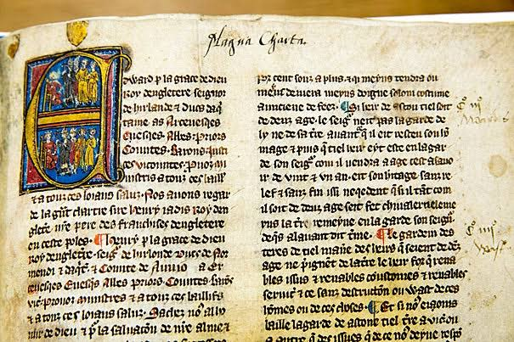
HABEAS CORPUS
HISTORY
  Originated in England with the Magna Carta
  Referred to as the Great Writ because of its importance as a check on governmental power
PROCESS
  A prisoner petitions the court to review their detention
  The government must prove (show cause) that it has a lawful right to hold the person
IMPORTANCE
  Used by prisoners to challenge detention, before or after conviction
  Used before the Civil War to challenge slavery and after to challenge arbitrary detention
  Used by Guantanamo Bay detainees to challenge military detention
  Used widely today to challenge ICE detention

Slide 16
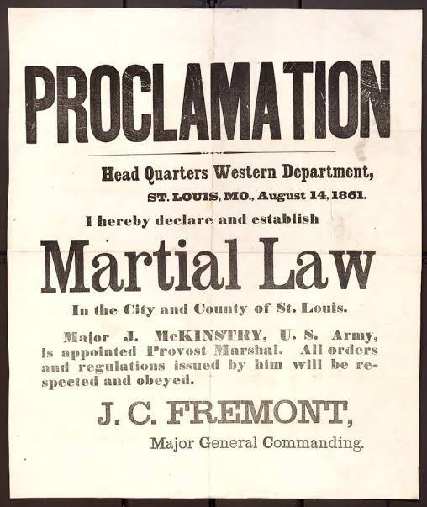
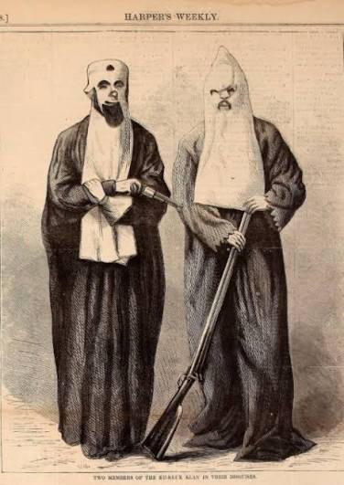
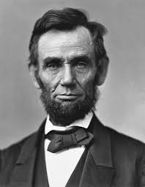
SUSPENDING HABEAS CORPUS
President Lincoln suspended habeas during the civil war
Ulysses S. Grant suspended it during the reconstruction era to fight the Ku Klux Klan
Habeas was suspended and martial law was imposed in Hawaiʻi in the aftermath of the attack on Pearl Harbor.

Slide 17
HAS COMMON LAW HABEAS CORPUS BEEN SUPPLANTED BY STATUTE IN HAWAI‘I?
STATUTE
“Issuable by whom. The supreme court, the justices thereof, and the circuit courts may issue writs of habeas corpus in cases in which persons are unlawfully restrained of their liberty….” HRS Chapter 660
CONSTITUTION
“The privilege of the writ of habeas corpus shall not be suspended unless, when in cases of rebellion or invasion, the public safety may require it.” Haw. Const. art. I, § 15
CASE LAW
“Undoubtedly the right to the writ could not be taken away by statute but that is quite a different matter from prescribing by what courts, in what manner and under what conditions, within reasonable limits, it may be exercised.” Brown v. Goto, 16 Haw. 263, 265 (1904)
Characterizing HRS Chapter 660 as a statute “dealing with procedural matters” Eason v. State, 157 Hawai‘i 252, 269 (2025)
“[C]ommon law may generally be overridden by statute.” Priceline.com, Inc. v. Dir. of Taxation, 144 Hawai‘i 72, 82 (2019)

Slide 18
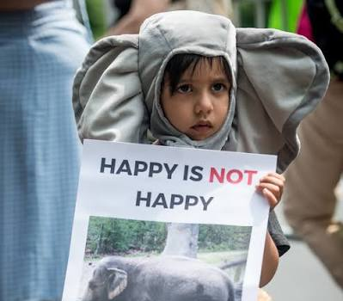

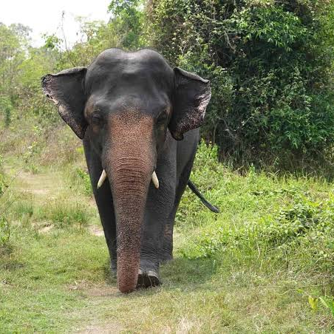
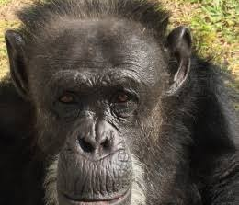
RIGHTS OF NATURE &
ANIMAL PERSONHOOD
Ecuador (2008) Codified the Rights of Nature in the national constitution
New Zealand (2017) Passed legislation granting legal personhood to the Whanganui River
Panama (2022) Enacted legislation recognizing legal standing for national ecosystems
Argentina (2016) Judge sustained habeas petition for Cecilia the chimpanzee and ordered her transfer from a zoo to an animal sanctuary
Pakistan (2020) Court ruled that captive animals have natural rights and ordered transfer of Kaavan the elephant to a sanctuary
New York (2022) High court rejected habeas petition; however, two of the seven justice dissented.

Slide 19
AMICUS BRIEFS
An amicus brief is a written legal document submitted to a court by a person or group who is not a direct party to the case, but has a strong interest in its outcome. The term comes from the Latin phrase amicus curiae, which translates directly to “friend of the court.”
Amicus briefs may offer specialized knowledge or expertise. They may also make legal arguments different from that of the parties.
Several briefs were submitted supporting various aspects of the NhRP case: the cognitive capacity of elephants, the historical parallels to the use of habeas to recognize the personhood for the enslaved and oppressed, and the Hawaii Supreme Court’s willingness to break new legal ground.
The Hawaiʻi Veterinary Medical Association also submitted a brief supporting the City & County position, arguing that granting personhood status would not actually promote animal welfare.

Slide 20

WHAT WILL HAPPEN?
The Court could hold that HRS Chapter 660 is the controlling legal authority, and that a plain language reading of the statute shows that it does not apply to elephants.
The Court could hold that the common law habeas rule still applies to this issue. However, even under common law, habeas does not apply to elephants.
Or the Court could hold that NhRP has established a prima facie case that Mari and Vaigai may be entitled to habeas protections and issue an Order to Show Cause. This would result in further factual inquiry as to whether the legal personhood of elephants should be recognized.

Slide 21
RELEVANT SOURCES OF LAW
Brown v. Goto, 16 Haw. 263, 265 (1904)
Eason v. State, 157 Hawai‘i 252, 269 (2025)
Priceline.com, Inc. v. Dir. of Taxation, 144 Hawai‘i 72, 82 (2019)
HRS Chapter 660
Haw. Const. art. I, § 15

Slide 22
ANY QUESTIONS?

